Slide 1
Module 21: ASA Firewall Configuration
Instructor Materials
Networking Security v1.0
(NETSEC)
Notes:
Networking Security (NETSEC) Module 21: ASA Firewall Configuration

Slide 2
Instructor Materials – Module 21 Planning Guide
This PowerPoint deck is divided in two parts:
Instructor Planning Guide
Information to help you become familiar with the module
Teaching aids
Instructor Class Presentation
Optional slides that you can use in the classroom
Begins on slide # 11
Note: Remove the Planning Guide from this presentation before sharing with anyone.
For additional help and resources go to the Instructor Home Page and Course Resources for this course. You also can visit the professional development site on netacad.com, the official Cisco Networking Academy Facebook page, or Instructor Only FB group.

Slide 3
What to Expect in this Module
To facilitate learning, the following features within the GUI may be included in this module:
Feature | Description
Animations | Expose learners to new skills and concepts.
Videos | Expose learners to new skills and concepts.
Check Your Understanding(CYU) | Per topic online quiz to help learners gauge content understanding.
Interactive Activities | A variety of formats to help learners gauge content understanding.
Syntax Checker | Small simulations that expose learners to Cisco command line to practice configuration skills.
PT Activity | Simulation and modeling activities designed to explore, acquire, reinforce, and expand skills.

Slide 4
What to Expect in this Module (Cont.)
To facilitate learning, the following features may be included in this module:
Feature | Description
Hands-On Labs | Labs designed for working with physical equipment.
Class Activities | These are found on the Instructor Resources page. Class Activities are designed to facilitate learning, class discussion, and collaboration.
Module Quizzes | Self-assessments that integrate concepts and skills learned throughout the series of topics presented in the module.
Module Summary | Briefly recaps module content.

Slide 5
Check Your Understanding
Check Your Understanding activities are designed to let students quickly determine if they understand the content and can proceed, or if they need to review.
Check Your Understanding activities do not affect student grades.
There are no separate slides for these activities in the PPT. They are listed in the notes area of the slide that appears before these activities.
Notes:
5

Slide 6
Module 21: Activities
What activities are associated with this module?
Page # | Activity Type | Activity Name | Optional?
21.2.3 | Syntax Checker | Configure Basic Settings on an ASA 5506-X | Recommended
21.2.5 | Syntax Checker | Configure Inside, Outside, and DMZ Interfaces on an ASA 5506-X | Recommended
21.2.7 | Syntax Checker | Configure a Default Static Route on an ASA 5506-X | Recommended
21.2.9 | Syntax Checker | Enable SSH Remote Access Using the Local Database on an ASA 5506-X | Recommended
21.2.10 | Lab (Optional) | Configure ASA Basic Settings Using the CLI | Optional
21.2.12 | Syntax Checker | Enable NTP with Authentication on an ASA 5506-X | Recommended
21.2.14 | Syntax Checker | Configure DHCP Services | Recommended
21.3.6 | Check Your Understanding | Identify Types of Object Groups | Recommended

Slide 7
Module 21: Activities
What activities are associated with this module?
Page # | Activity Type | Activity Name | Optional?
21.4.9 | Syntax Checker | Configure an ASA ACL Using Object Groups with the CLI | Recommended
21.5.3 | Syntax Checker | Configure ASA Dynamic NAT with the CLI | Recommended
21.5.6 | Syntax Checker | Configure the ASA DMZ and Static NAT with the CLI | Recommended
21.6.4 | Syntax Checker | Configure AAA on the ASA with the CLI | Recommended
21.7.4 | Syntax Checker | Define and Activate a Policy | Recommended
21.7.5 | Packet Tracer | Configure ASA Basic Settings and Firewall Using the CLI | Recommended
21.7.6 | Lab (optional) | Configure ASA Network Services, Routing, and DMZ with ACLs Using CLI | Optional
21.8.2 | Module Quiz | ASA Firewall Configuration Quiz | Recommended

Slide 8
Module 21: Best Practices
Prior to teaching Module 21, the instructor should:
Review the activities and assessments for this module.
Try to include as many questions as possible to keep students engaged during classroom presentation.
Topic 21.1
Tell the class “The ASA CLI is very similar but not identical to an ISR.”
Ask the class “What command would you use on an ISR to ….”
Topic 21.2
Ask the class “What basic tasks should be configured on an ASA?” Elicit the same as a router; device hostname, passwords, usernames, interfaces, …
Notes:
8

Slide 9
Module 21: Best Practices (Cont.)
Topic 21.3
Tell the class “Assume you need to configure access to 10 servers using an ACL and it takes one ACE per server.”
Ask the class “What could we do to make this simpler to configure.” Elicit grouping the servers as a network object group and applying one ACE to the group.
Topic 21.4
Ask the class “On an ISR, how can you create a standard/extended ACL?” Elicit using numbers or name.
Tell the class “The ASA supports only named ACLs.”
Topic 21.5
Ask the class “How does the ASA provide dynamic network address translation services.” Elicit by using object groups.
Notes:
9

Slide 10
Module 21: Best Practices (Cont.)
Topic 21.6
Ask the class “How did you configure AAA on an ISR?” Elicit enabling AAA, enabling authentication, configuring server access, …
Tell the class “Configuring AAA on an ASA is similar.”
Topic 21.7
Ask the class “Have you ever configured class maps and service policy maps?” Elicit yes when they configured ZPF.
Tell the class “The ASA uses the Modular Policy Framework (MPF) configuration to define a set of rules for applying firewall features to the traffic that traverses the ASA.”
Notes:
10

Slide 11
Module 21: ASA Firewall Configuration
Networking Security v1.0
(NETSEC)
Notes:
Networking Security (NETSEC) Module 21: ASA Firewall Configuration

Slide 12
Module Objectives
Module Title: ASA Firewall Configuration
Module Objective: Implement an ASA firewall configuration.
Topic Title | Topic Objective
Basic ASA Firewall Configuration | Explain how to configure an ASA-5506-X with FirePOWER Services.
Configure Management Settings and Services | Configure management settings and services on an ASA 5506-X firewall.
Object Groups | Explain how to configure object groups on an ASA.
ASA ACLs | Use the correct commands to configure access lists with object groups on an ASA.
NAT Services on an ASA | Use the correct commands to configure an ASA to provide NAT services.
AAA | Use correct commands to configure access control using the local database and AAA server.
Service Policies on an ASA | Configure service policies on an ASA
Introduction to ASDM (Optional) | Note: This is an optional topic that is not assessed.
Notes:
12
21 – ASA Firewall Configuration
21.0.2 – What will I learn to do in this module?

Slide 13
21.1 Basic ASA Firewall Configuration
Notes:
21: ASA Firewall Configuration 21.1: Basic ASA Firewall Configuration

Slide 14
Basic ASA Firewall Configuration
Basic ASA Settings
The ASA command line interface (CLI) is a proprietary OS, which has a similar look and feel to the router IOS.
For example, the ASA CLI contains command prompts similar to that of a Cisco IOS router.
Abbreviation of commands and keywords
Use of the Tab key to complete a partial command
Use of the help key (?) after a command to view additional syntax
Notes:
21: ASA Firewall Configuration 21.1: Basic ASA Firewall Configuration 21.1.1: Basic ASA Settings

Slide 15
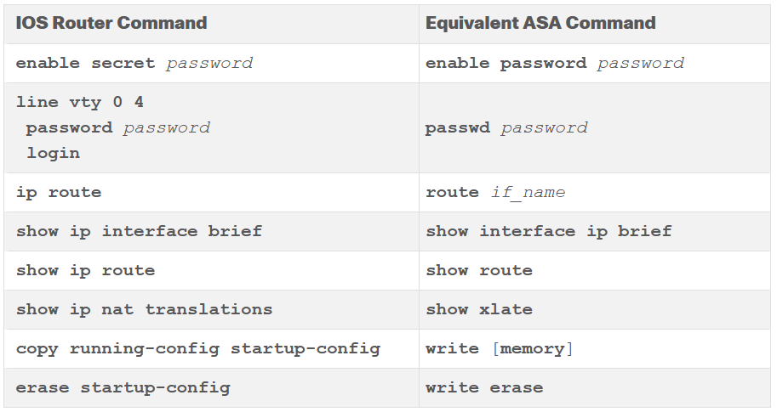
Basic ASA Firewall Configuration
Basic ASA Settings (Cont.)
The table contrasts common IOS router and ASA commands.
Notes:
21: ASA Firewall Configuration 21.1: Basic ASA Firewall Configuration 21.1.1: Basic ASA Settings

Slide 16
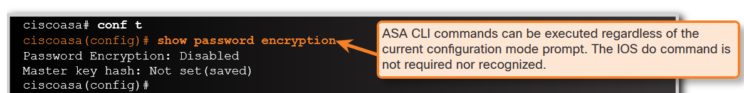
Basic ASA Firewall Configuration
Basic ASA Settings (Cont.)
ASA CLI commands can be executed regardless of the current configuration mode prompt.
Notes:
21: ASA Firewall Configuration 21.1: Basic ASA Firewall Configuration 21.1.1: Basic ASA Settings

Slide 17
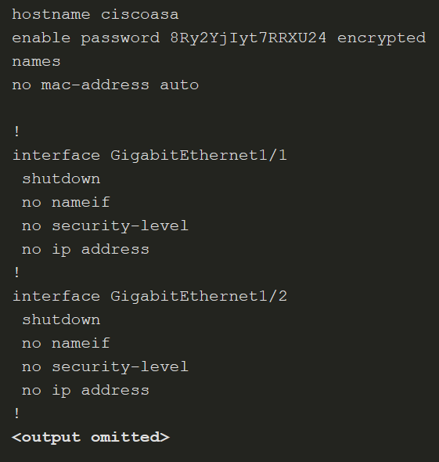
Basic ASA Firewall Configuration
ASA Default Configuration
The ASA 5506-X with FirePOWER Services ships with a default configuration that, in most instances, is sufficient for a basic SOHO deployment. Use the configure factory-default global configuration mode command to restore the factory default configuration.
The default hostname is ciscoasa. By default, the privileged EXEC and console line passwords are not configured.
These settings can be changed by:
Manually using the CLI
Interactively using the CLI Setup Initialization wizard
Using the ASDM Startup wizard
Notes:
21: ASA Firewall Configuration 21.1: Basic ASA Firewall Configuration 21.1.2: ASA Default Configuration

Slide 18
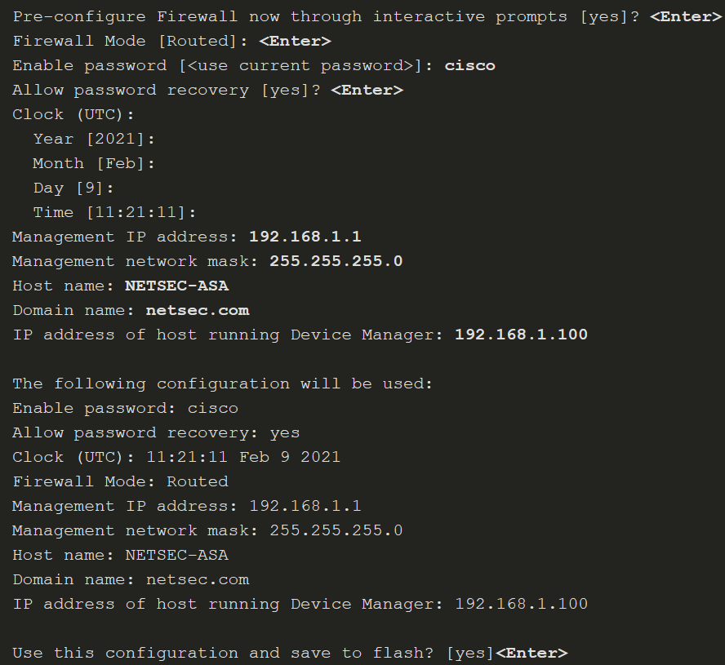
Basic ASA Firewall Configuration
ASA Interactive Setup Initialization Wizard
The wizard is displayed when there is no startup configuration, and prompts “Pre-configure Firewall now through interactive prompts [yes]?” To cancel and display the ASA default user EXEC mode prompt, enter no. Otherwise, enter yes or simply press Enter to accept the default [yes]. This initiates the wizard and the ASA interactively guides an administrator to configure the default settings.
Notes:
21: ASA Firewall Configuration 21.1: Basic ASA Firewall Configuration 21.1.3: ASA Interactive Setup Initialization Wizard

Slide 19
21.2 Configure Management Settings and Services
Notes:
21: ASA Firewall Configuration 21.2: Configure Management Settings and Services

Slide 20
Configure Management Settings and Services
Enter Global Configuration Mode
The default ASA user prompt of ciscoasa> is displayed when an ASA configuration is erased, the device is rebooted, and the user does not use the interactive setup wizard.
To enter privileged EXEC mode, use the enable user EXEC mode command. Initially, an ASA does not have a password configured; therefore, when prompted, leave the enable password prompt blank and press Enter.
The ASA date and time should be set either manually or by using Network Time Protocol (NTP). To set the date and time, use the clock set privileged EXEC command.
Enter global configuration mode using the configure terminal privileged EXEC command.
Notes:
21: ASA Firewall Configuration 21.2: Configure Management Settings and Services 21.2.1: Enter Global Configuration Mode

Slide 21
Configure Management Settings and Services
Configure Basic Settings
An ASA must be configured with basic management settings. The table displays the commands to accomplish this task.
ASA Command | Description
hostname name | Specifies a hostname up to 63 characters. A hostname must start and end with a letter or digit, and have as interior characters only letters, digits, or a hyphen.
domain-name name | Sets the default domain name.
enable password password | Sets the enable password for privileged EXEC mode. Sets the password as a case-sensitive string of 3 to 32 alphanumeric and special characters (not including a question mark or a space).
banner motd message | Provides legal notification and configures the system to display a message-of-the-day banner when connecting to the ASA.
key config-key password-encryption [ new-pass [ old-pass ]] | Sets the passphrase between 8 and 128 character long. Used to generate the encryption key.
password encryption aes | Enables password encryption and encrypts all user passwords.
Notes:
21: ASA Firewall Configuration 21.2: Configure Management Settings and Services 21.2.2: Configure Basic Settings

Slide 22
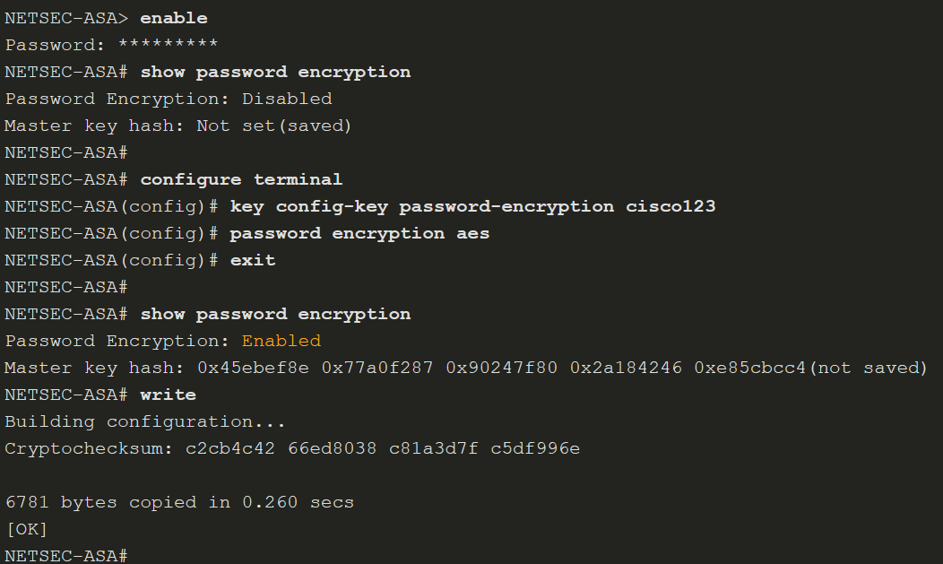
Configure Management Settings and Services
Configure Basic Settings (Cont.)
To configure a banner with several lines, the banner motd must be entered multiple times.
The privileged EXEC password is automatically encrypted using MD5. However, stronger encryption using AES should be enabled. To do so, a master passphrase must be configured, and AES encryption must be enabled.
To change the master passphrase, use the key config-key password-encryption password command. To determine if password encryption is enabled, use the show password encryption command.
Notes:
21: ASA Firewall Configuration 21.2: Configure Management Settings and Services 21.2.2: Configure Basic Settings
21.2.3: Syntax Checker - Configure Basic Settings on an ASA 5506-X

Slide 23
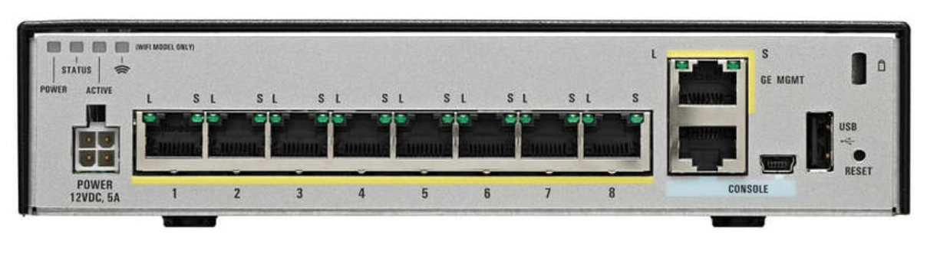
Configure Management Settings and Services
Configure Interfaces
The ASA-5506-X has eight Gigabit Ethernet interfaces that can be configured to carry traffic from different networks. The G1/1 interface is used by convention as the outside interface and is set to receive its IP address over DHCP by default.
The remaining interfaces, G1/2-G1/8, can be assigned to inside networks or DMZs. In addition, a Gigabit Ethernet port is dedicated to in-band management. It is designated as Management1/1. There are also RJ45 and USB console connections for out-of-band management.
Notes:
21: ASA Firewall Configuration 21.2: Configure Management Settings and Services 21.2.4: Configure Interfaces

Slide 24
Configure Management Settings and Services
Configure Interfaces (Cont.)
The IP address of an interface can be configured using one of the following options:
Manually - Commonly used to assign an IP address and mask to the interface.
DHCP - Used when an interface is connecting to an upstream device providing DHCP services.
PPPoE - Used when an interface is connecting to an upstream DSL device providing point-to-point connectivity over Ethernet services
The table lists the commands to configure an IP address on an interface.
To Configure | ASA Command | Description
Manually | ip address ip-address netmask | Assigns an IP address to the interface.
Using DHCP | ip address dhcp | The interface will request an IP address configuration from the upstream device.
 | ip address dhcp setroute | Used to have the interface request and install a default route to the upstream device.
Using PPP0E | ip address pppoe | Interface configuration mode command that requests an IP address from the upstream device.
 | ip address pppoe setroute | Same command but it also requests and installs a default route to the upstream device.
Notes:
21: ASA Firewall Configuration 21.2: Configure Management Settings and Services 21.2.4: Configure Interfaces

Slide 25
Configure Management Settings and Services
Configure Interfaces (Cont.)
Each interface must have a security level from 0 (lowest) to 100 (highest).
The commands below are used to configure basic interface parameters.
Verify the interface addressing and status with the show interface ip brief command as shown below. Note that the show command does not need to be entered in User EXEC mode.
ASA Command | Description
nameif if_name | Names the interface using a text string of up to 48 characters. The name is not case-sensitive. You can change the name by re-entering this command with a new value. Do not enter the no form, because that command causes all commands that refer to that name to be deleted.
security-level value | Sets the security level, where number is an integer between 0 (lowest) and 100 (highest).
no shutdown | Activate the interface.
Notes:
21: ASA Firewall Configuration 21.2: Configure Management Settings and Services 21.2.4: Configure Interfaces
21.2.5: Syntax Checker - Configure Inside, Outside, and DMZ Interfaces on an ASA 5506-X

Slide 26
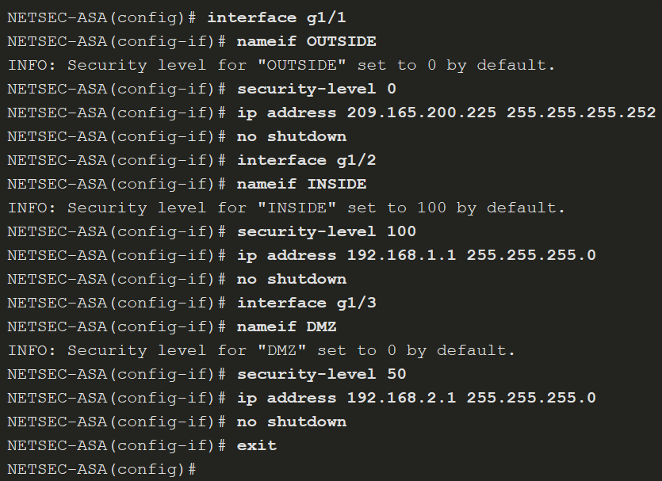
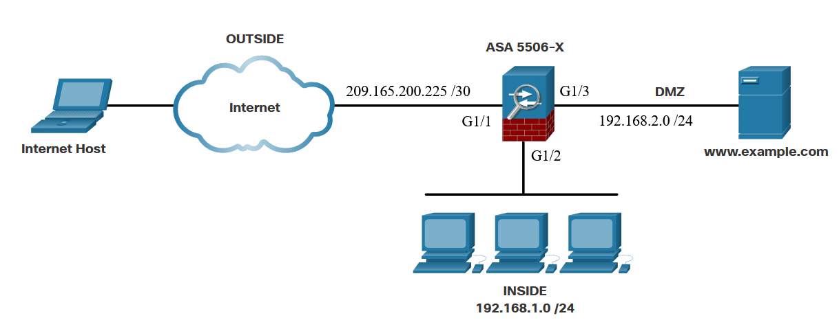
Configure Management Settings and Services
Configure Interfaces (Cont.)
Interface configuration example
Notes:
21: ASA Firewall Configuration 21.2: Configure Management Settings and Services 21.2.4: Configure Interfaces
21.2.5: Syntax Checker - Configure Inside, Outside, and DMZ Interfaces on an ASA 5506-X

Slide 27
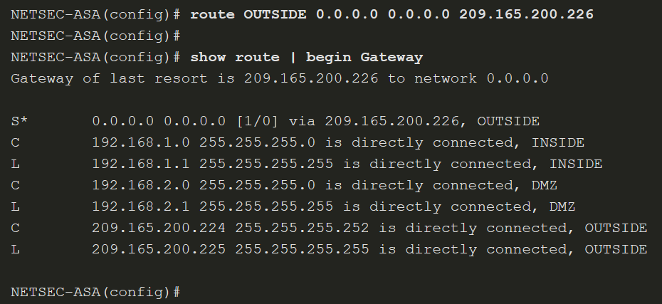
Configure Management Settings and Services
Configure a Default Static Route
Use the route interface-name 0.0.0.0 0.0.0.0 next-hop-ip-address command to configure a default route.
Notes:
21: ASA Firewall Configuration 21.2: Configure Management Settings and Services 21.2.6: Configure a Default Static Route
21.2.7: Syntax Checker - Configure a Default Static Route on an ASA 5506-X

Slide 28
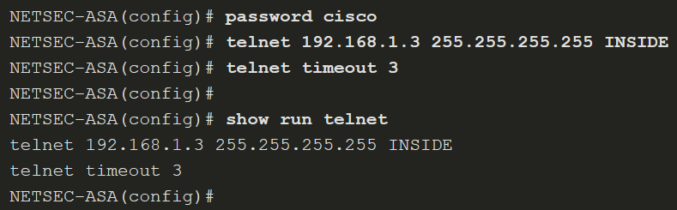
Configure Management Settings and Services
Configure Remote Access Services
Telnet or SSH is required to manage the ASA 5506-X remotely, using the CLI. To enable the Telnet service, use the commands listed in the table.
ASA Command | Description
{passwd | password} password | Sets the login password up to 80 characters in length for Telnet.
telnet { ipv4_address mask | ipv6_address/prefix } if_name | Identifies which inside host or network can Telnet to the ASA interface. Use the clear configure telnet command to remove the Telnet connection
telnet timeout minutes | By default, Telnet sessions left idle for five minutes are closed by the ASA. The command alters the default exec timeout of five minutes.
aaa authentication telnet console LOCAL | Configures Telnet to refer to the local database for authentication. The LOCAL keyword is case sensitive and is a predefined server tag.
clear configure telnet | Removes the Telnet connection from the configuration.
Notes:
21: ASA Firewall Configuration 21.2: Configure Management Settings and Services 21.2.8: Configure Remote Access Services

Slide 29
Configure Management Settings and Services
Configure Remote Access Services (Cont.)
To enable SSH, use the commands that are listed in the table. Example configuration is on the next slide
ASA Command | Description
username name password password | Creates a local database entry.
aaa authentication ssh console LOCAL | Configures SSH to refer to the local database for authentication. The LOCAL keyword is case sensitive and is a predefined server tag.
crypto key generate rsa modulus modulus_size | Generates the RSA key required for SSH encryption. The modulus_size (in bits) can be 512, 768, 1024, or 2048. A value of 2048 is recommended.
ssh { ip_address mask | ipv6_address/prefix } if_name | Identifies which inside host or network can SSH to the ASA interface. Multiple commands can be in the configuration. If the if_name is not specified, SSH is enabled on all interfaces except the outside interface. Use the clear configure ssh command to remove the SSH connection.
ssh version version_number | (Optional) By default, the ASA allows both SSH Version 1 (less secure) and Version 2 (more secure). Enter this command in order to restrict the connections to a specific version.
ssh timeout minutes | Alters the default exec timeout of five minutes.
clear configure ssh | Removes the SSH connection from the configuration.
Notes:
21: ASA Firewall Configuration 21.2: Configure Management Settings and Services 21.2.8: Configure Remote Access Services
21.2.9: Syntax Checker - Enable SSH Remote Access Using the Local Database on an ASA 5506-X

Slide 30
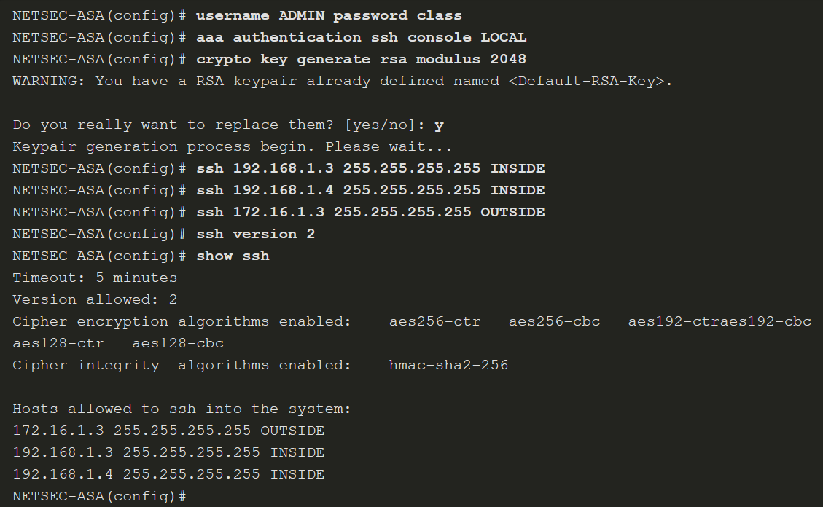
Configure Management Settings and Services
Configure Remote Access Services (Cont.)
Notes:
21: ASA Firewall Configuration 21.2: Configure Management Settings and Services 21.2.8: Configure Remote Access Services
21.2.9: Syntax Checker - Enable SSH Remote Access Using the Local Database on an ASA 5506-X

Slide 31
Configure Management Settings and Services
Optional Lab - Configure ASA Basic Settings Using the CLI
In this lab, you will complete the following objectives:
Part 1: Configure Basic Device Settings
Part 2: Access the ASA Console and Use CLI Setup Mode to Configure Basic Settings
Part 3: Configure Basic ASA Settings and Interface Security Levels
Notes:
21: ASA Firewall Configuration 21.2: Configure Management Settings and Services 21.2.10: Optional Lab - Configure ASA Basic Settings Using the CLI

Slide 32
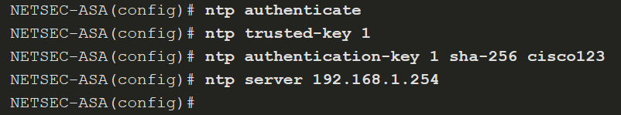
Configure Management Settings and Services
Configure Network Time Protocol Services
Network Time Protocol (NTP) services can be enabled on an ASA to obtain the date and time from an NTP server. To enable NTP, use the global configuration mode commands listed in the table. To verify the NTP configuration and status, use the show ntp status and show ntp associations commands
ASA Command | Description
ntp authenticate | Enables authentication with an NTP server.
ntp trusted-key key_id | Specifies an authentication key ID to be a trusted key, which is required for authentication with an NTP server.
ntp authentication-key key_id md5 key | Sets a key to authenticate with an NTP server.
ntp server ip_address [ key key_id ] | Identifies an NTP server.
Notes:
21: ASA Firewall Configuration 21.2: Configure Management Settings and Services 21.2.11: Configure Network Time Protocol Services
21.2.12: Syntax Checker - Enable NTP with Authentication on an ASA 5506-X

Slide 33
Configure Management Settings and Services
Configure DHCP Services
An ASA can be configured to be a DHCP server to provide IP addresses and DHCP-related information to hosts. To enable an ASA as a DHCP server and provide DHCP services to hosts, use the commands listed in the table. Example on the next slide
ASA Command | Description
dhcpd address IP_address1 [ -IP_address2 ] if_name | Creates a DHCP address pool in which IP_address1 is the start of the pool and IP_address2 is the end of the pool, separated by a hyphen. The address pool must be on the same subnet as the ASA interface.
dhcpd dns dns1 [ dns2 ] | (Optional) Specifies the IP address(es) of the DNS server(s).
dhcpd lease lease_length | (Optional) Changes the lease length granted to the client which is the amount of time in seconds that the client can use its allocated IP address before the lease expires. The lease_length defaults to 3600 seconds (1 hour) but can be a value from 0 to 1,048,575 seconds.
dhcpd domain domain_name | (Optional) Specifies the domain name assigned to the client.
dhcpd enable if_name | Enables the DHCP server service (daemon) on the interface (typically the inside interface) of the ASA.
Notes:
21: ASA Firewall Configuration 21.2: Configure Management Settings and Services 21.2.13: Configure DHCP Services
21.2.14: Syntax Checker - Configure DHCP Services

Slide 34
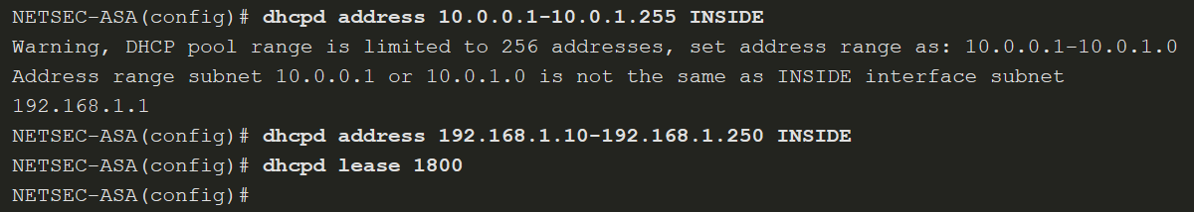
Configure Management Settings and Services
Configure DHCP Services (Cont.)
Notes:
21: ASA Firewall Configuration 21.2: Configure Management Settings and Services 21.2.13: Configure DHCP Services
21.2.14: Syntax Checker - Configure DHCP Services

Slide 35
21.3 Object Groups
Notes:
21: ASA Firewall Configuration 21.3: Object Groups

Slide 36
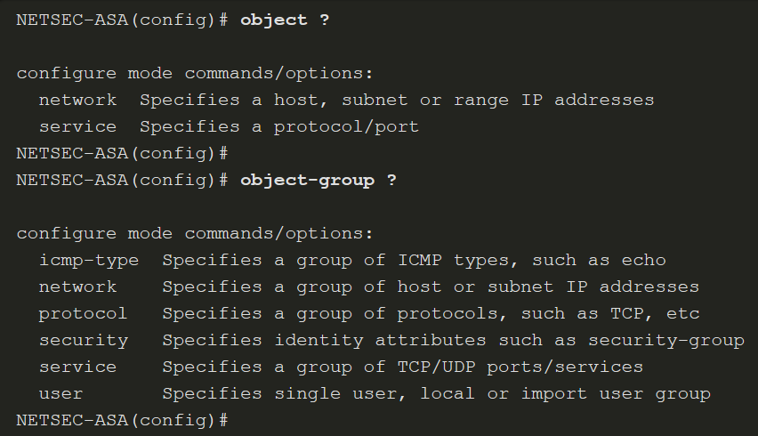
Object Groups
Introduction to Objects and Object Groups
Objects are reusable components for use in configurations. Objects can be defined and used in Cisco ASA configurations in the place of inline IP addresses, services, names, and so on.
The ASA supports objects and object groups, as shown in the output in the following output from the help facility:
Notes:
21: ASA Firewall Configuration 21.3: Object Groups 21.3.1: Introduction to Objects and Object Groups

Slide 37
Object Groups
Configure Network Objects
To create a network object, use the object network object-name global configuration mode command. The prompt changes to network object configuration mode.
Network objects can consist of the following:
host - a host address
fqdn - a fully-qualified domain name
range - a range of IP addresses
subnet - an entire IP network or subnet
Notes:
21: ASA Firewall Configuration 21.3: Object Groups 21.3.2: Configure Network Objects

Slide 38
Object Groups
Configure Network Objects (Cont.)
Commands available in network object configuration mode are shown in the table.
ASA Command | Description
attribute attribute-agent attribute-type attribute-value | Defined and used to filter traffic associated with one or more virtual machines.
description | Enter a description of the object up to 200 characters in length.
fqdn | A fully-qualified domain name such as the name of a host, such as www.example.com. Specify v4 to limit the address to IPv4, and v6 for IPv6. If you do not specify an address type, IPv4 is assumed.
host ip-address | The IPv4 or IPv6 address of a single host.
range start_add end_add | A range of addresses. You can specify IPv4 or IPv6 ranges. Do not include masks or prefixes.
subnet {ipv4_add ipv4_mask | ipv6_add/ipv6_prefix} | Assigns a network subnet to the named object.
Notes:
21: ASA Firewall Configuration 21.3: Object Groups 21.3.2: Configure Network Objects

Slide 39
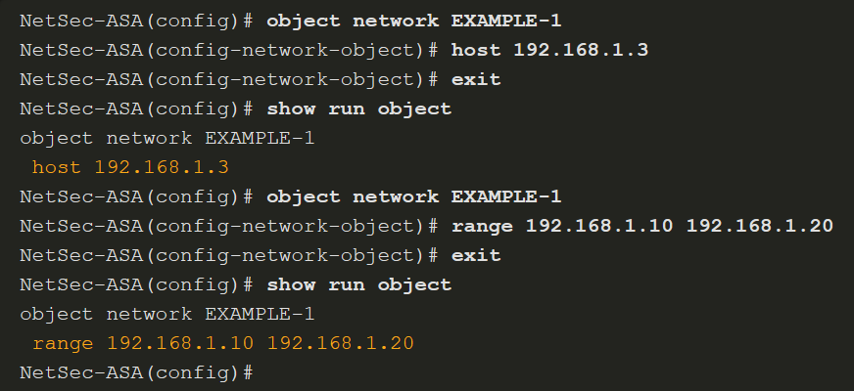
Object Groups
Configure Network Objects (Cont.)
The example displays a sample network object configuration. Notice that the configuration of range overwrites the previous configuration of host.
Notes:
21: ASA Firewall Configuration 21.3: Object Groups 21.3.2: Configure Network Objects

Slide 40
Object Groups
Configure Service Objects
The table provides an overview of common service options available. Optional keywords are used to identify source port or destination port, or both. Operators such as eq (equal), neq (not equal), lt (less than), gt (greater than), and range, support configuring a port for a given protocol. If no operator is specified, the default operator is eq.
Use the no form of the command to remove a service object. To erase all service objects, use the clear config object service command.
ASA Command | Description
service protocol | Specifies an IP protocol name or number.
service tcp [source operator port] [destination operator port] | Specifies that the service object is for the TCP protocol.
service udp [source operator port] [destination operator port] | Specifies that the service object is for the UDP protocol.
service icmp [icmp-type [icmp_code]] | Specifies that the service object is for the ICMP protocol.
service icmp6 [icmp-type [icmp_code]] | Specifies that the service object is for the ICMPv6 protocol.
Notes:
21: ASA Firewall Configuration 21.3: Object Groups 21.3.3: Configure Service Objects

Slide 41
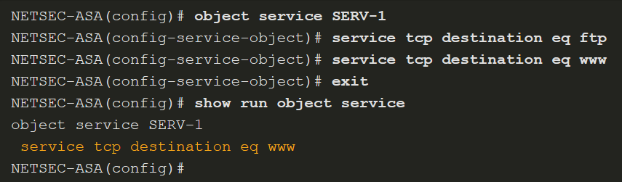
Object Groups
Configure Service Objects (Cont.)
A service object name can only be associated with one protocol and port (or ports), as shown in the show run object service output in this example.
Notes:
21: ASA Firewall Configuration 21.3: Object Groups 21.3.3: Configure Service Objects

Slide 42
Object Groups
Object Groups
Objects can be grouped together to create an object group. By grouping like objects together, an object group can be used in an access control entry (ACE) instead of having to enter an ACE for each object separately.
The following guidelines and limitations apply to object groups:
Objects and object groups share the same name space.
Object groups must have unique names.
An object group cannot be removed or emptied if it is used in a command.
The ASA does not support IPv6 nested object groups.
Notes:
21: ASA Firewall Configuration 21.3: Object Groups 21.3.4: Object Groups

Slide 43
Object Groups
Object Groups (Cont.)
There are five types of object groups.
Network - A network-based object group specifies a list of IP host, subnet, or network addresses.
User - Locally created, as well as imported Active Directory user groups can be defined for use in features that support the identity firewall.
Service - A service-based object group is used to group TCP, UDP, or TCP and UDP ports into an object. The ASA enables the creation of a service object group that can contain a mix of TCP services, UDP services, ICMP-type services, and any protocol, such as ESP, GRE, and TCP.
ICMP-Type - The ICMP protocol uses unique types to send control messages (RFC 792). The ICMP-type object group can group the necessary types required to meet an organization’s security needs, such as to create an object group called ECHO to group echo and echo-reply.
Security - A security group object group can be used in features that support Cisco TrustSec by including the group in an extended ACL, which in turn can be used in an access rule.
Notes:
21: ASA Firewall Configuration 21.3: Object Groups 21.3.4: Object Groups

Slide 44
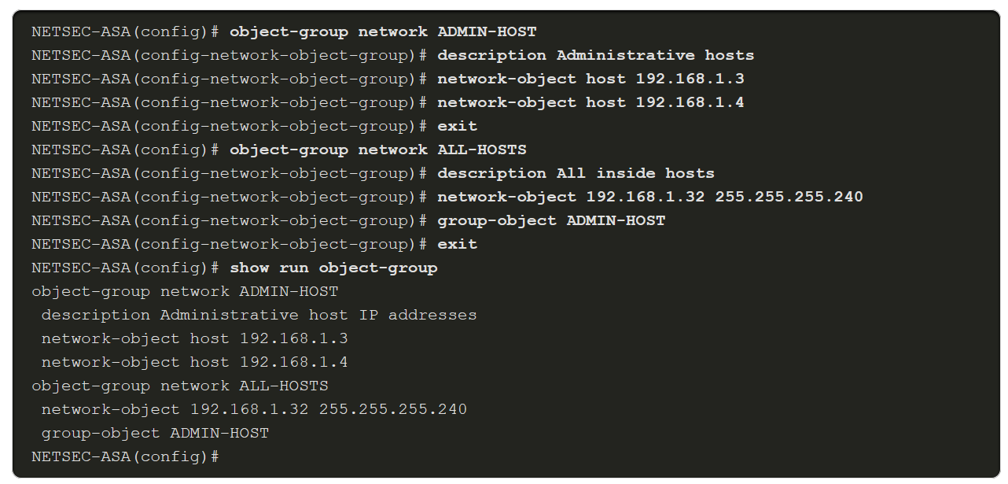
Object Groups
Configure Common Object Groups
To configure a network object group, use the object-group network grp-name global configuration mode command. After entering the command, add network objects to the network group using the network-object and group-object commands.
To configure an ICMP object group, use the object-group icmp-type grp-name global configuration mode command. After entering the command, add ICMP objects to the ICMP object group using the icmp-object and group-object commands.
The example displays a sample network object group configuration.
Notes:
21: ASA Firewall Configuration 21.3: Object Groups 21.3.5: Configure Common Object Groups
21.3.6: Check Your Understanding - Identify Types of Object Groups

Slide 45
21.4 ASA ACLs
Notes:
21: ASA Firewall Configuration 21.4: ASA ACLs

Slide 46
ASA ACLs
ASA ACLs
These are the similarities between ASA ACLs and IOS ACLs:
ACLs are made up of one or more ACEs. ACEs are applied to a protocol, a source and destination IP address, a network, or the source and destination ports.
ACLs are processed sequentially from top down.
A criteria match will cause the ACL to be exited.
There is an implicit deny any at the bottom.
Remarks can be added per ACE or ACL.
Only one access list can be applied per interface, per protocol, per direction.
ACLs can be enabled/disabled based on time ranges.
These the differences between ASA ACLs and IOS ACLs:
The ASA uses a network mask (e.g., 255.255.255.0) and not a wildcard mask (e.g. 0.0.0.255).
ACLs are always named instead of numbered.
By default, interface security levels apply access control without an ACL configured.
Notes:
21: ASA Firewall Configuration 21.4: ASA ACLs 21.4.1: ASA ACLs

Slide 47
ASA ACLs
Types of ASA ACL Filtering
ACLs on a security appliance can be used not only to filter packets that are passing through the appliance but also to filter packets destined for the appliance.
Through-traffic filtering - Traffic passing through the ASA from one interface to another interface. The configuration is completed in two steps: configure the ACL, then apply the ACL to an interface.
To-the-box-traffic filtering - management access rule that applies to traffic that terminates at the ASA.
ASA devices differ from their router counterparts because of interface security levels. By default, security levels apply access control without an ACL configured.
Notes:
21: ASA Firewall Configuration 21.4: ASA ACLs 21.4.2: Types of ASA ACL Filtering

Slide 48
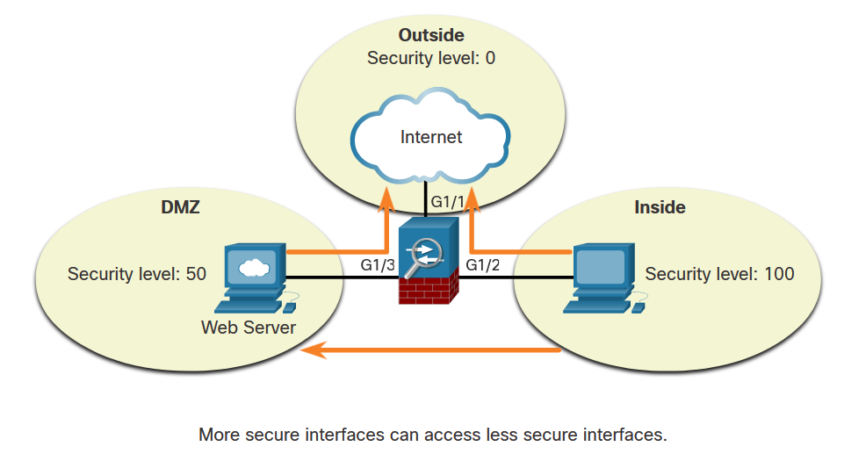
ASA ACLs
Types of ASA ACL Filtering (Cont.)
ASA devices differ from their router counterparts because of interface security levels. By default, security levels apply access control without an ACL configured.
Notes:
21: ASA Firewall Configuration 21.4: ASA ACLs 21.4.2: Types of ASA ACL Filtering

Slide 49
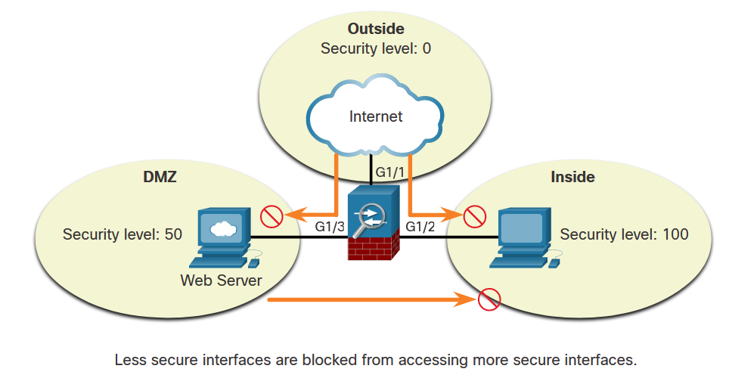
ASA ACLs
Types of ASA ACL Filtering (Cont.)
However, a host from an outside interface with security level 0 cannot access the inside higher-level interface, as shown below.
Notes:
21: ASA Firewall Configuration 21.4: ASA ACLs 21.4.2: Types of ASA ACL Filtering

Slide 50
ASA ACLs
Types of ASA ACL Filtering (Cont.)
A from an outside interface with security level 0 cannot access the inside higher-level interface, as shown in the figure.
Use the same-security-traffic permit inter-interface to enable traffic between interfaces with the same security level. Use the same-security-traffic permit intra-interface command to allow traffic to enter and exit the same interface
Notes:
21: ASA Firewall Configuration 21.4: ASA ACLs 21.4.2: Types of ASA ACL Filtering

Slide 51
ASA ACLs
Types of ASA ACLs
The ASA supports five types of access lists:
Extended access list - The most common type of ACL.
Standard access list - Unlike IOS where a standard ACL identifies the source host/network, ASA standard ACLs are used to identify the destination IP addresses. Standard access lists cannot be applied to interfaces to control traffic.
EtherType access list - An EtherType ACL can be configured only if the security appliance is running in transparent mode.
Webtype access list - Used for filtering for clientless SSL VPN traffic. These ACLs can deny access based on URLs or destination addresses.
IPv6 access list - Used to determine which IPv6 traffic to block and which traffic to forward at router interfaces.
Use the help access-list privileged EXEC command to display the syntax for all of the ACLs supported on an ASA platform.
Notes:
21: ASA Firewall Configuration 21.4: ASA ACLs 21.4.3: Types of ASA ACLs

Slide 52
ASA ACLs
Types of ASA ACLs (Cont.)
The table provides examples of the uses of extended ACLs.
ACL Use | Description
Control network access for IP traffic | The ASA does not allow any traffic from a lower security interface to a higher security interface unless it is explicitly permitted by an extended access list.
Identify traffic for AAA rules | AAA rules use access lists to identify traffic.
Identify addresses for NAT | Policy NAT lets you identify local traffic for address translation by specifying the source and destination addresses in an extended access list.
Establish VPN access | Extended access list can be used in VPN commands.
Identify traffic for Modular Policy Framework (MPF) | Access lists can be used to identify traffic in a class map, which is used for features that support MPF. Features that support MPF include TCP, general connection settings, and inspection.
Notes:
21: ASA Firewall Configuration 21.4: ASA ACLs 21.4.3: Types of ASA ACLs

Slide 53
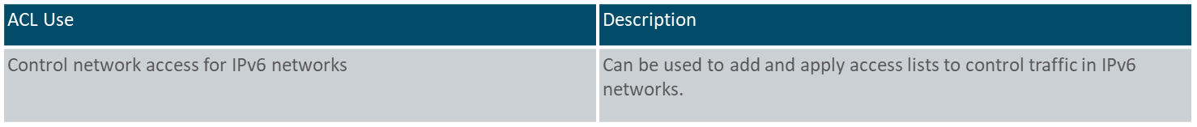
ASA ACLs
Types of ASA ACLs (Cont.)
The table provides examples of uses of standard ACLs.
ACL Use | Description
Identify OSPF destination network in route maps | Standard access lists include only the destination address. It can be used to control the redistribution of OSPF routes.
VPN filters | Filter traffic for LAN-to-LAN (L2L), Cisco VPN Client, and the Cisco AnyConnect Secure Mobility Client traffic.
The table provides examples of uses of IPv6 ACLs.
Notes:
21: ASA Firewall Configuration 21.4: ASA ACLs 21.4.3: Types of ASA ACLs

Slide 54
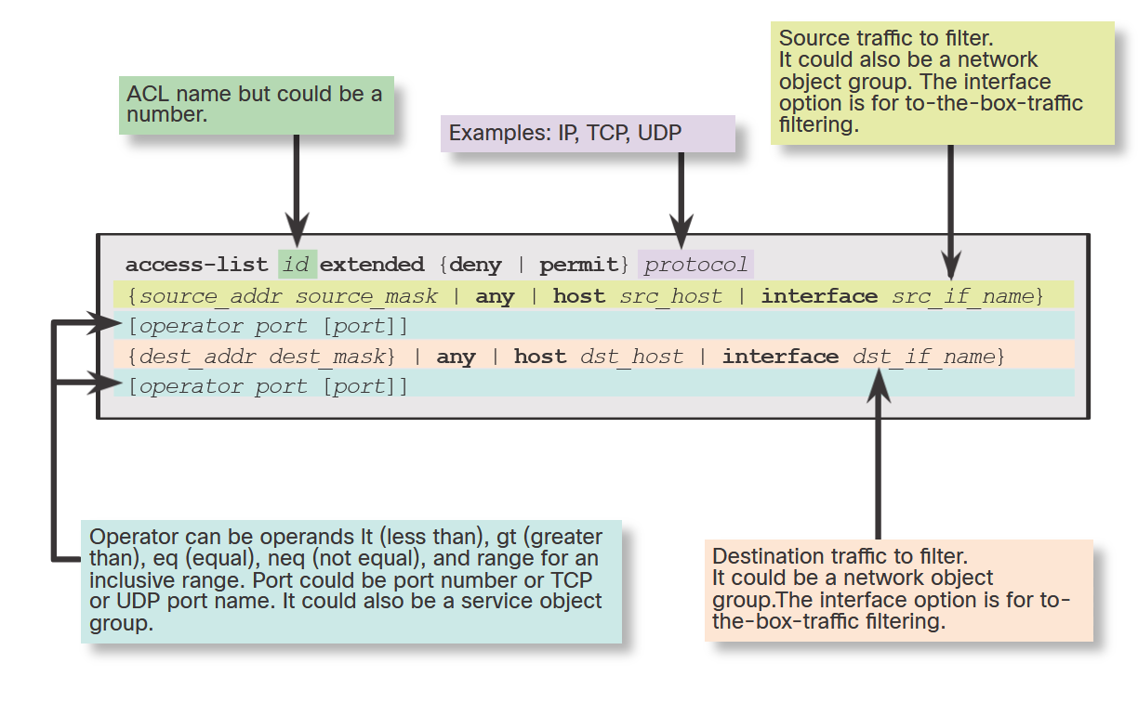
ASA ACLs
Syntax for Configuring an ASA ACL
IOS and ASA ACLs have similar elements, but some options vary with the ASA.
There are many options that can be used with ACLs. However, for most needs, a more useful and condensed version of the syntax is shown in the figure.
Notes:
21: ASA Firewall Configuration 21.4: ASA ACLs 21.4.4: Configure ACLs

Slide 55
ASA ACLs
Syntax for Configuring an ASA ACL (Cont.)
The table describes elements of an ASA ACL.
Element | Description
ACL id | The name of the ACL.
Action | Can be permit or deny.
Protocol number - Source | Can be IP for all traffic, or the name / IP protocol number (0-250) including icmp ( 1), tcp ( 6), udp ( 17), or a protocol object-group.
Source | Identifies the source and can be any, a host, a network, or a network object group. For to-the-box-traffic filtering, the interface keyword is used to specify the source interface of the ASA.
Source port operator | (Optional) Operand is used in conjunction with the source port. Valid operands include lt (less than), gt (greater than), eq (equal), neq (not equal), and range for an inclusive range.
Source port | (Optional) Can be the actual TCP or UDP port number, select port names, or service object group.
Destination | Identifies the destination and like the source, it can be any, a host, a network, or a network object group. For to-the-box-traffic filtering, the interface keyword is used to specify the destination interface of the ASA.
Destination port operator | (Optional) Operand is used in conjunction with the destination port. Valid operands are the same as the source port operands.
Destination port | (Optional) Can be the actual TCP or UDP port number, select port names, or service object group.
Log | Can set elements for syslog including severity level and log interval.
Time range | (Optional) Specify a time range for the ACE.
Notes:
21: ASA Firewall Configuration 21.4: ASA ACLs 21.4.4: Configure ACLs

Slide 56
ASA ACLs
Syntax for Applying an ASA ACL
The example displays the command syntax and parameter description for applying the ACL to an interface using the access-group command syntax. To verify ACLs, use the show access-list and show running-config access-list commands. To erase a configured ACL, use the clear configure access-list id command.
Syntax | Description
access-group | Keyword used to apply an ACL to an interface.
id | The name of the actual ACL to be applied to an interface.
in | The ACL will filter inbound packets.
out | The ACL will filter outbound packets.
interface | Keyword to specify the interface to which to apply the ACL.
if_name | The name of the interface to which to apply an ACL.
per-user-override | Option that allows downloadable ACLs to override the entries on the interface ACL.
control-plane | Keyword to specify whether the applied ACL analyzes traffic destined to ASA for management purposes.
Notes:
21: ASA Firewall Configuration 21.4: ASA ACLs 21.4.5: Apply ACLs

Slide 57
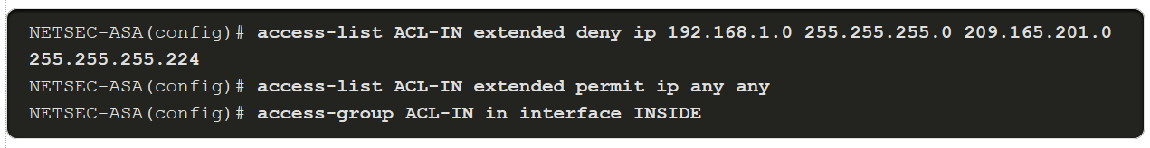
ASA ACLs
ASA ACL Examples
Example 1
ACL allows all hosts on the inside network to go through the ASA.
By default, all other traffic is denied unless explicitly permitted.
Example 2
ACL prevents hosts on 192.168.1.0/24 from accessing the 209.165.201.0/27 network.
Internal hosts are permitted access to all other addresses.
All other traffic is implicitly denied.
Notes:
21: ASA Firewall Configuration 21.4: ASA ACLs 21.4.6: ACLs and Object Groups

Slide 58
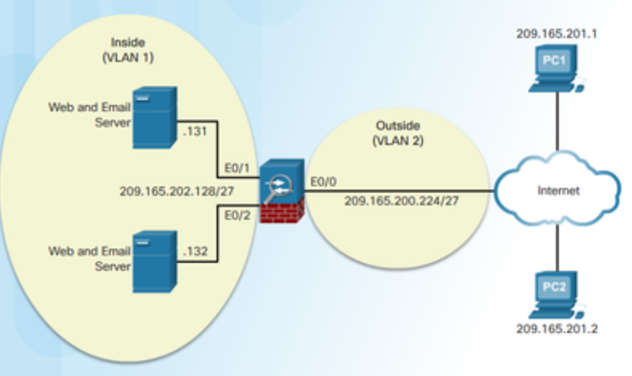
ASA ACLs
ACLs and Object Groups
Consider the sample topology in the figure in which access from two trusted, remote hosts, PC1 and PC2, should be allowed to the two internal for web and email servers. All other traffic attempting to pass through the ASA should be dropped and logged.
The ACL would require two ACEs for each PC to accomplish the task. The implicit deny any drops and logs any packets that do not match email or web services. As shown in the example, ACLs should always be thoroughly documented using the remark command.
To verify the ACL syntax, use the show running-config access-list and show access-list commands, as shown in the example.
Notes:
21: ASA Firewall Configuration 21.4: ASA ACLs 21.4.7: ACLs and Object Groups

Slide 59
ASA ACLs
ACL Using Object Groups Examples
Object grouping is a way to group similar items together to reduce the number of ACEs.
Object grouping can cluster network objects into one group and outside hosts into another, as shown in the following syntax. The security appliance can also combine both TCP services into a service object group.
Notes:
21: ASA Firewall Configuration 21.4: ASA ACLs 21.4.7: ACL Using Object Groups Examples
21.4.8: Syntax Checker - Configure an ASA ACL Using Object Groups with the CLI

Slide 60
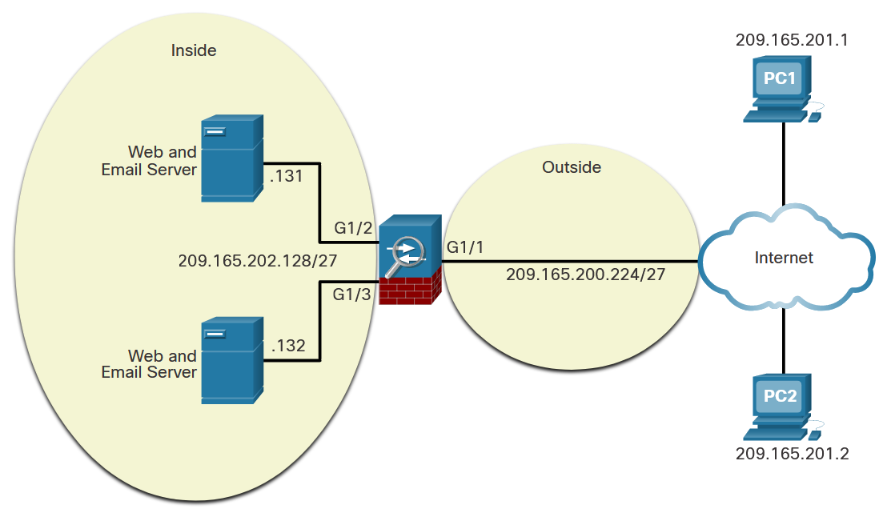
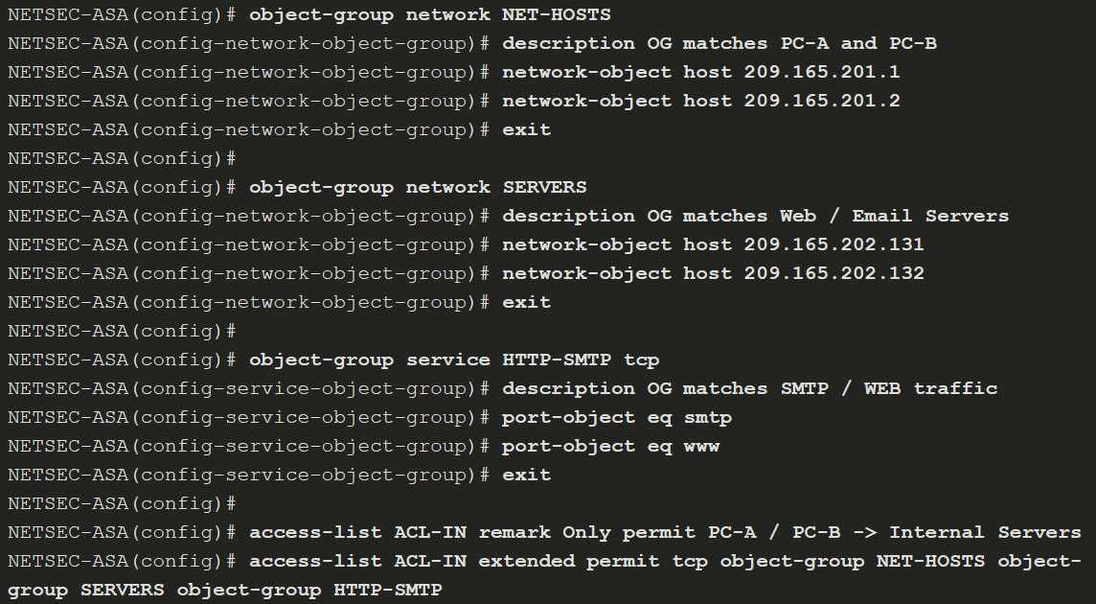
ASA ACLs
ACL Using Object Groups Examples (Cont.)
This example shows how to configure the following three object groups:
NET-HOSTS - Identifies two external hosts.
SERVERS - Identifies servers providing email and web services.
HTTP-SMTP - Identifies SMTP and HTTP protocols.
Notes:
21: ASA Firewall Configuration 21.4: ASA ACLs 21.4.7: ACL Using Object Groups Examples
21.4.8: Syntax Checker - Configure an ASA ACL Using Object Groups with the CLI

Slide 61
21.5 NAT Services on an ASA
Notes:
21: ASA Firewall Configuration 21.5: NAT Services on an ASA

Slide 62
NAT Services on an ASA
ASA NAT Overview
NAT can be deployed using one of the methods:
Inside NAT
Outside NAT
Bidirectional NAT
Specifically, the Cisco ASA supports the following common types of NAT:
Dynamic PAT - This is a many-to-one translation. This is also known as NAT with overload. Usually, an inside pool of private addresses overloading an outside interface or outside address.
Static NAT - This is a one-to-one translation. Usually an outside address mapping to an internal server.
Policy NAT - Policy-based NAT is based on a set of rules.
Identity NAT - A real address is statically translated to itself, essentially bypassing NAT.
Notes:
21: ASA Firewall Configuration 21.5: NAT Services on an ASA 21.5.1: ASA NAT Overview

Slide 63
NAT Services on an ASA
Configure Dynamic NAT
To configure network object dynamic NAT, two network objects are required:
Identify the pool of public IP addresses with the range or subnet network object commands.
Identify the internal addresses to be translated with the range or subnet network object commands.
The two network objects are then bound together using nat [(real_if_name,mapped_if_name)] dynamic mapped_obj [interface [ipv6]] [dns] network object command. The real_if_name is the prenat interface. The mapped_if_name is the postnat interface. Notice that there is no space after the comma in the command syntax.
Notes:
21: ASA Firewall Configuration 21.5: NAT Services on an ASA 21.5.2: Configure Dynamic NAT
21.5.3: Syntax Checker - Configure ASA Dynamic NAT with the CLI

Slide 64
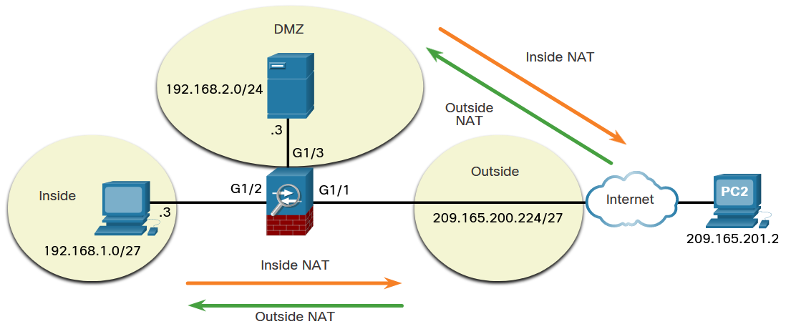
NAT Services on an ASA
Configure Dynamic NAT (Cont.)
In this dynamic NAT example, the inside hosts on the 192.168.1.0/27 network will be dynamically assigned a range of public IP address from 209.165.200.240 to 209.165.200.248.
Notes:
21: ASA Firewall Configuration 21.5: NAT Services on an ASA 21.5.2: Configure Dynamic NAT
21.5.3: Syntax Checker - Configure ASA Dynamic NAT with the CLI

Slide 65
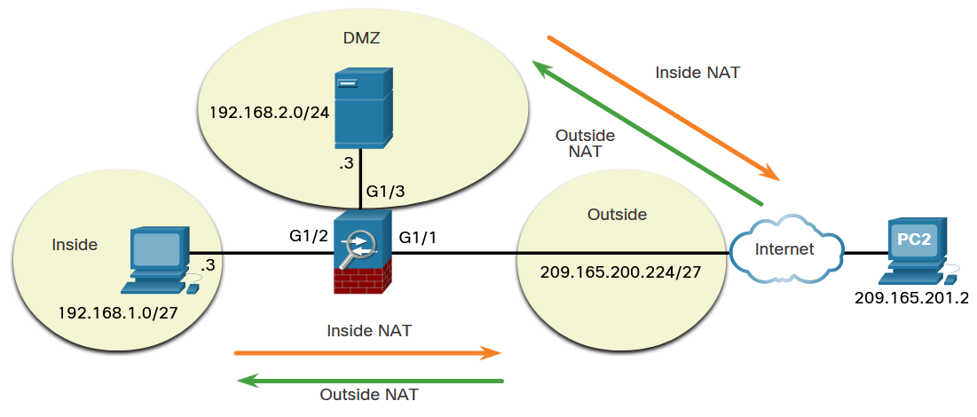
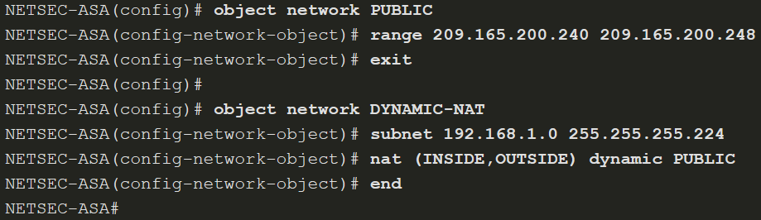
NAT Services on an ASA
Configure Dynamic NAT (Cont.)
The example displays a sample dynamic NAT configuration to accomplish this task. The PUBLIC network object identifies the public IP addresses to be translated to while the DYNAMIC-NAT object identifies the internal addresses to be translated and is bound to the PUBLIC network object with the nat command.
Notes:
21: ASA Firewall Configuration 21.5: NAT Services on an ASA 21.5.2: Configure Dynamic NAT
21.5.3: Syntax Checker - Configure ASA Dynamic NAT with the CLI

Slide 66
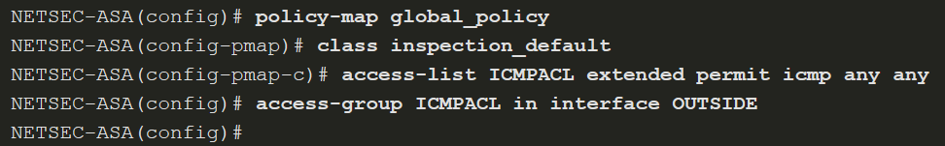
NAT Services on an ASA
Configure Dynamic NAT (Cont.)
The following example shows how to allow inside hosts to ping outside hosts.
To verify the network address translation, use show xlate, show nat, and show nat detail commands.
Notes:
21: ASA Firewall Configuration 21.5: NAT Services on an ASA 21.5.2: Configure Dynamic NAT
21.5.3: Syntax Checker - Configure ASA Dynamic NAT with the CLI

Slide 67
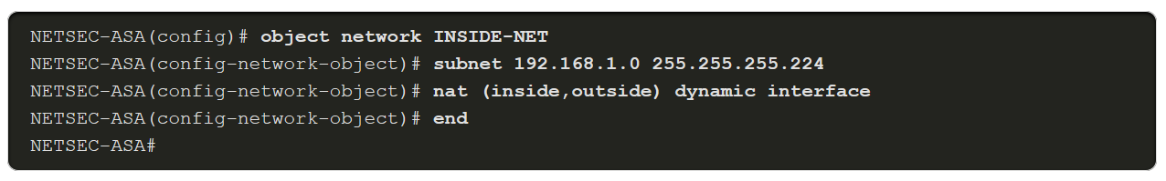
NAT Services on an ASA
Configure Dynamic PAT
To enable inside hosts to overload the outside address, use nat [(real_if_name,mapped_if_name)] dynamic interface command, as shown in the example.
Notes:
21: ASA Firewall Configuration 21.5: NAT Services on an ASA 21.5.4: Configure Dynamic PAT

Slide 68
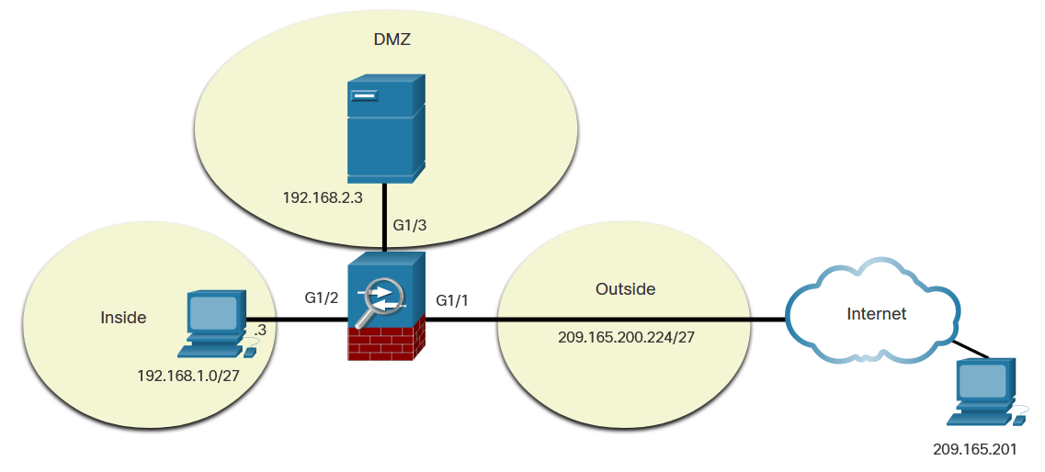
NAT Services on an ASA
Configure Static NAT
Static NAT is configured when an inside address is mapped to an outside address. For instance, static NAT can be used when a server must be accessible from the outside.
To configure static NAT, use the nat [(real_if_name,mapped_if_name)] static mapped-inline-host-ip network object command. The example configuration is on the next slide.
Notes:
21: ASA Firewall Configuration 21.5: NAT Services on an ASA 21.5.5: Configure Static NAT
21.5.6: Syntax Checker - Configure the ASA DMZ and Static NAT with the CLI

Slide 69
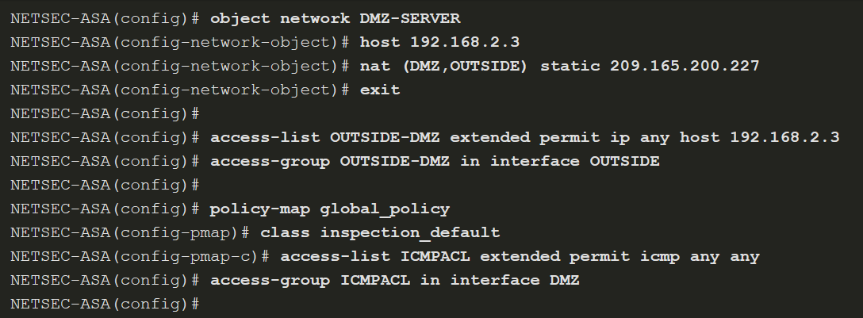
NAT Services on an ASA
Configure Static NAT (Cont.)
Notes:
21: ASA Firewall Configuration 21.5: NAT Services on an ASA 21.5.5: Configure Static NAT
21.5.6: Syntax Checker - Configure the ASA DMZ and Static NAT with the CLI

Slide 70
21.6 AAA
Notes:
21: ASA Firewall Configuration 21.6: AAA

Slide 71
AAA
AAA Review
Authentication, authorization, and accounting (AAA) provides an extra level of protection and user control. Using AAA only, authenticated and authorized users can be permitted to connect through the ASA.
Authorization controls access, per user, after users are authenticated. Authorization controls the services and commands that are available to each authenticated user.
Accounting tracks traffic that passes through the ASA, enabling administrators to have a record of user activity.
Notes:
21: ASA Firewall Configuration 21.6: AAA 21.6.1: AAA Review

Slide 72
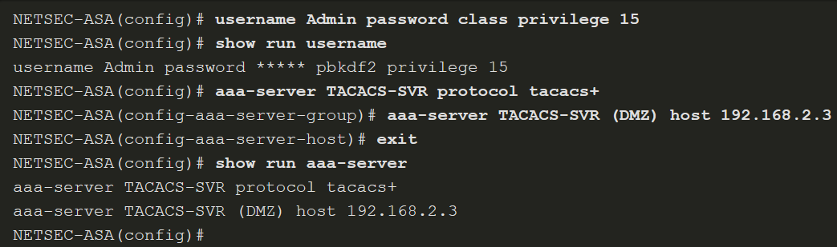
AAA
Local Database and Servers
Use the username name password password [privilege priv-level] command to create local user accounts. To erase a user from the local database, use the clear config username [name] command. To view all user accounts, use the show running-config username command.
To configure a TACACS+ or RADIUS server, use the commands listed in the table.
ASA Command | Description
aaa-server server-tag protocol protocol | Creates a TACACS+ or RADIUS AAA server group.
aaa-server server-tag [(-interface name )] host {server-ip | name } [ key ] | Configures a AAA server as part of a AAA server group. Also configures AAA server parameters that are host-specific.
The example shows configuration of a AAA TACACS+ server on an ASA 5506-X.
Notes:
21: ASA Firewall Configuration 21.6: AAA 21.6.2: Local Database and Servers

Slide 73
AAA
AAA Configuration
To authenticate users who access the ASA CLI over a console (serial), SSH, HTTPS (ASDM), or Telnet connection, or to authenticate users who access privileged EXEC mode using the enable command, use the aaa authentication enable console command in global configuration mode.
Notes:
21: ASA Firewall Configuration 21.6: AAA 21.6.3: AAA Configuration
21.6.4: Syntax Checker - Configure AAA on the ASA with the CLI

Slide 74
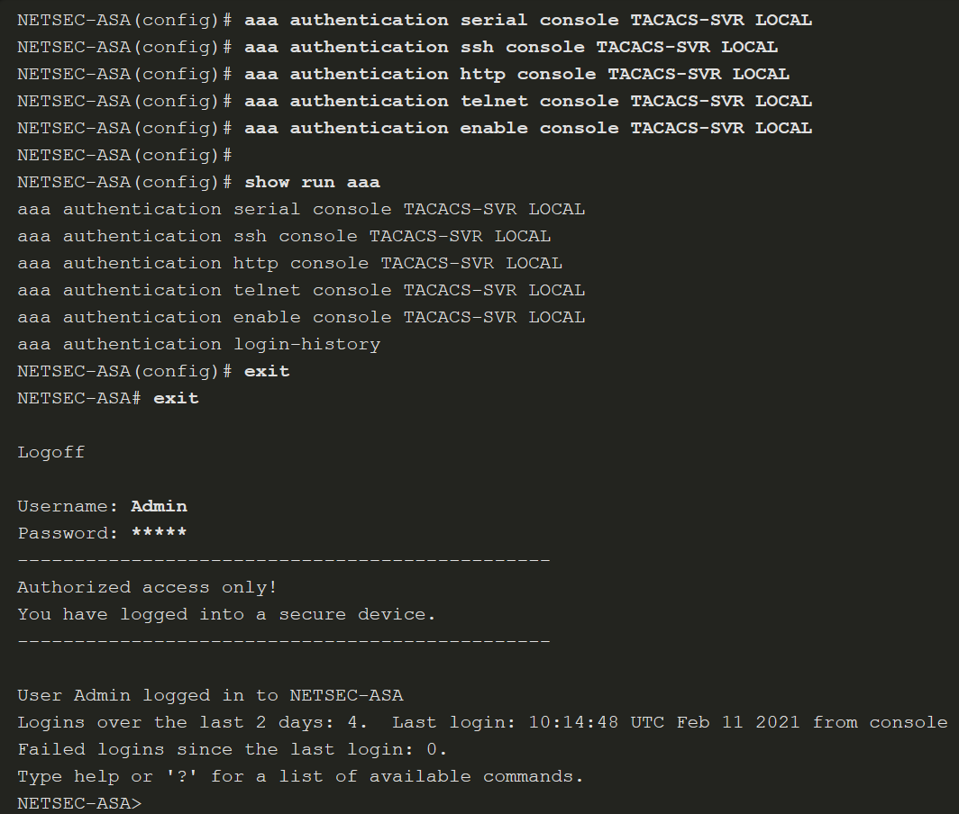
AAA
AAA Configuration (Cont.)
The example provides a sample AAA configuration that is then verified and tested.
Notes:
21: ASA Firewall Configuration 21.6: AAA 21.6.3: AAA Configuration
21.6.4: Syntax Checker - Configure AAA on the ASA with the CLI

Slide 75
21.7 Service Policies on an ASA
Notes:
21: ASA Firewall Configuration 21.7: Service Policies on an ASA

Slide 76
Service Policies on an ASA
Overview of MPF
A Modular Policy Framework (MPF) configuration defines a set of rules for applying firewall features, such as traffic inspection and QoS, to the traffic that traverses the ASA. MPF allows granular classification of traffic flows, which enables the application of different advanced policies to different flows.
Cisco MPF uses three configuration objects to define modular, object-oriented, hierarchical policies:
Class Maps - What are we looking for?
Policy Maps - What shall we do with it?
Service Policy - Where do we do it?
Notes:
21: ASA Firewall Configuration 21.7: Service Policies on an ASA 21.7.1: Overview of MPF

Slide 77
Service Policies on an ASA
Overview of MPF (Cont.)
There are four steps to configure MPF on an ASA:
Step 1. (Optional) Configure extended ACLs to identify granular traffic that can be specifically referenced in the class map.
Step 2. Configure the class map to identify traffic.
Step 3. Configure a policy map to apply actions to those class maps.
Step 4. Configure a service policy to attach the policy map to an interface.
Notes:
21: ASA Firewall Configuration 21.7: Service Policies on an ASA 21.7.1: Overview of MPF

Slide 78
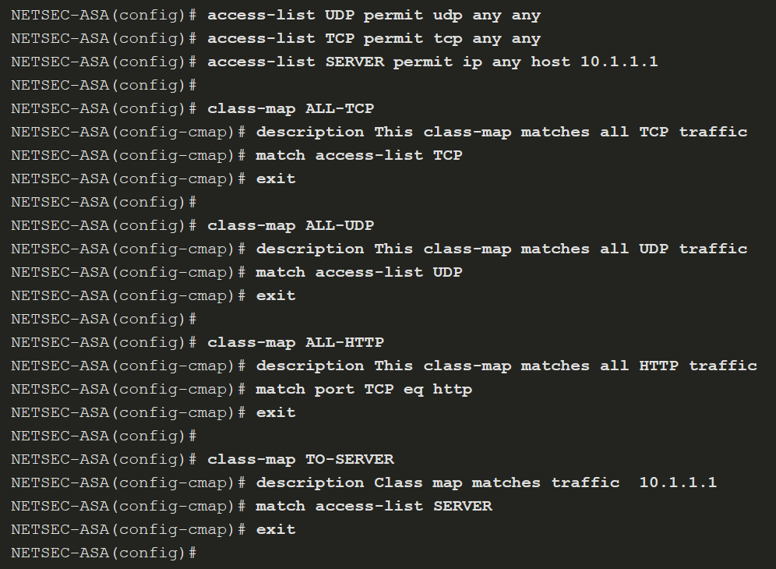
Service Policies on an ASA
Configure Class Maps
To create a class map and enter class-map configuration mode, use the class-map class-map-name global configuration mode command.
Next, traffic to match should be identified using the match any (matches all traffic) or match access-list access-list-name commands to match traffic specified by an extended access list.
Notes:
21: ASA Firewall Configuration 21.7: Service Policies on an ASA 21.7.2: Configure Class Maps

Slide 79
Service Policies on an ASA
Define and Activate a Policy
Use the policy-map policy-map-name global configuration mode command, to apply actions to the Layer 3 and 4 traffic.
In policy-map configuration mode, config-pmap, use the following commands:
description - Add description text.
class class-map-name - Identify a specific class map on which to perform actions.
These are the three most common commands available in policy map configuration mode:
set connection - Sets connection values.
inspect - Provides protocol inspection servers.
police - Sets rate limits for traffic in this class.
To activate a policy map globally on all interfaces or on a targeted interface, use the service-policy policy-map-name [ global | interface intf ] global configuration mode command to enable a set of policies on an interface.
Notes:
21: ASA Firewall Configuration 21.7: Service Policies on an ASA 21.7.3: Define and Activate a Policy
21.7.4: Syntax Checker - Define and Activate a Policy

Slide 80
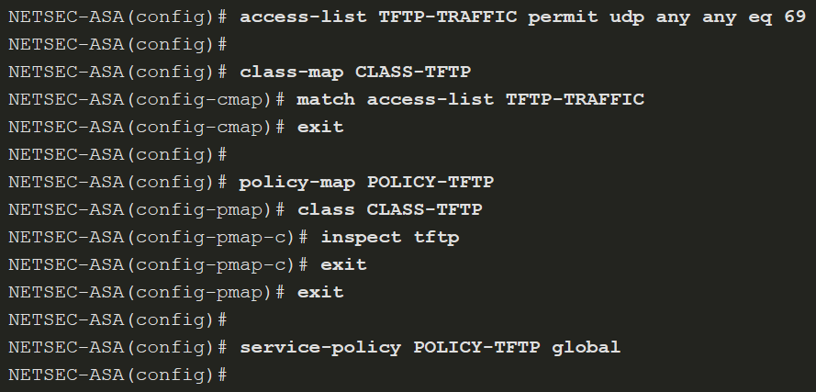
Service Policies on an ASA
Define and Activate a Policy (Cont.)
The example configures the policy map. Its associated service policy is applied globally.
Notes:
21: ASA Firewall Configuration 21.7: Service Policies on an ASA 21.7.3: Define and Activate a Policy
21.7.4: Syntax Checker - Define and Activate a Policy

Slide 81
Service Policies on an ASA
Packet Tracer - Configure ASA Basic Settings and Firewall Using the CLI
In this comprehensive Packet Tracer activity, you will complete the following objectives:
Verify connectivity and explore the ASA.
Configure basic ASA settings and interface security levels using the CLI.
Configure routing, address translation, and inspection policy using the CLI.
Configure DHCP, AAA, and SSH.
Configure a DMZ, Static NAT, and ACLs.
Notes:
21: ASA Firewall Configuration 21.7: Service Policies on an ASA 21.7.5: Packet Tracer - Configure ASA Basic Settings and Firewall Using the CLI

Slide 82
Service Policies on an ASA
Optional Lab - Configure ASA Network Services, Routing, and DMZ with ACLs Using CLI
In this comprehensive lab, you will complete the following objectives:
Part 1: Configure Basic Device Settings
Part 2: Configure Routing, Address Translation, and Inspection Policy Using the CLI
Part 3: Configure DHCP, AAA, and SSH
Part 4: Configure DMZ, Static NAT, and ACLs
Notes:
21: ASA Firewall Configuration 21.7: Service Policies on an ASA 21.7.6: Optional Lab - Configure ASA Network Services, Routing, and DMZ with ACLs Using CLI

Slide 83
21.8 ASA Firewall Configuration Summary
Notes:
21: ASA Firewall Configuration 21.8: ASA Firewall Configuration Summary

Slide 84
ASA Firewall Configuration Summary
What Did I Learn in this Module?
The ASA CLI contains command prompts similar to that of a Cisco IOS router.
Many commands are similar to those in other versions of IOS, however many differences also exist.
The ASA 5506-X with FirePOWER Services ships with a default configuration that, in most instances, is sufficient for a basic SOHO deployment.
The ASA 5506-X has eight Gigabit Ethernet interfaces that can be configured to carry traffic on different Layer 3 networks. The G1/1 interface is frequently configured as the outside interface to the ISP.
Basic configuration of interfaces includes IP addressing, naming, and setting the security level.
If the interface is configured with DHCP, a default route from an upstream device can automatically be configured on the ASA. Otherwise, a default route must be manually configured.
Objects make it easy to maintain configurations because an object can be modified in one place and the change will be reflected in all other places that are referencing it.
Network objects can include host addresses, subnets, ranges of addresses, and FQDNs.
Service objects can refer to different network services and protocols.
Object groups are collections of objects that are related.
Network object groups can also be used in configurations including ACLs and NAT.
Notes:
21: ASA Firewall Configuration 21.8: ASA Firewall Configuration Summary 21.8.1: What Did I Learn in this Module?

Slide 85
ASA Firewall Configuration Summary
What Did I Learn in this Module? (Cont.)
ASA ACLs differ from IOS ACLs in that they use a network mask (e.g., 255.255.255.0) instead of a wildcard mask (e.g. 0.0.0.255).
ASA ACLs must be grouped with an interface in order to go into effect. Object groups can be used with ASA ACLs to limit the number of ACEs that are required in a list.
There are three NAT deployment methods for the ASA: inside NAT, outside NAT, and bidirectional NAT.
The ASA supports four types of NAT: dynamic NAT with overload, static NAT, policy NAT, and identity NAT.
Cisco ASAs can be configured to authenticate access using a local user database or an external server for authentication or both.
A Modular Policy Framework (MPF) configuration defines a set of rules for applying firewall features, such as traffic inspection and QoS, to the traffic that traverses the ASA.
Class maps are used to identify the traffic that will be processed by MPF.
Policy maps define what will be done to the identified traffic.
Service policies identify which interfaces the policy map should be applied to.
Notes:
21: ASA Firewall Configuration 21.8: ASA Firewall Configuration Summary 21.8.1: What Did I Learn in this Module?
21.8.2: Module Quiz

Slide 86
ASA Firewall Configuration Summary
New Terms and Commands
configure factory-default domain-name name key config-key password-encryption [ new-pass [ old-pass ]] password encryption aes show password encryption ip address dhcp setroute ip address pppoe ip address pppoe setroute nameif if_name security-level value route interface-name 0.0.0.0 0.0.0.0 next-hop-ip-address {passwd | password} password | telnet { ipv4_address mask | ipv6_address/prefix } if_name telnet timeout minutes aaa authentication telnet console LOCAL clear configure telnet ssh { ip_address mask | ipv6_address/prefix } if_name ssh version version_number ssh timeout minutes clear configure ssh Network Time Protocol (NTP) ntp authenticate ntp trusted-key key_id ntp authentication-key key_id md5 key ntp server ip_address [ key key_id ]
Notes:
21 – ASA Firewall Configuration
New Terms and Commands

Slide 87
ASA Firewall Configuration Summary
New Terms and Commands
dhcpd address IP_address1 [ -IP_address2 ] if_name dhcpd dns dns1 [ dns2 ] dhcpd lease lease_length dhcpd domain domain_name dhcpd enable if_name object groups object network object-name object service object-name show run object service object-group network grp-name object-group icmp-type grp-name Through-traffic filtering To-the-box-traffic filtering | same-security-traffic permit inter-interface same-security-traffic permit intra-interface access-group id { in | out } interface if_name [ per-user-override | control-plane ] access-list id extended { deny | permit } protocol object-group source_net-obj-grp_id object-group dest_net-obj-grp_id object-group service-obj-grp_id nat [(real_if_name,mapped_if_name)] dynamic mapped_obj [interface [ipv6]] [dns] show xlate show nat show nat detail nat [(real_if_name,mapped_if_name)] static mapped-inline-host-ip aaa-server server-tag protocol destined
Notes:
21 – ASA Firewall Configuration
New Terms and Commands

Slide 88
ASA Firewall Configuration Summary
New Terms and Commands
aaa-server server-tag [(if_name)] host {server-ip | name } [ key ] username name password password [privilege priv-level] clear config username [name] Modular Policy Framework (MPF) class-map class-name policy-map policy-name service-policy serv-name [ global | interface if-name ]
Notes:
21 – ASA Firewall Configuration
New Terms and Commands

